Slide 1
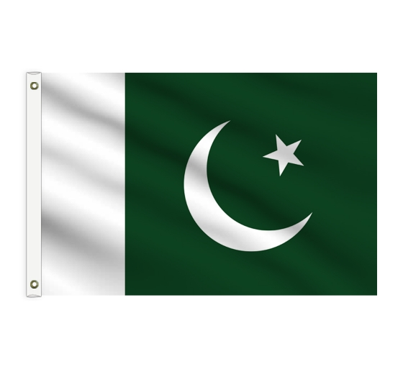
Cement Sector of Pakistan

Slide 2
Production capacity – (million tons)

Slide 3
Domestic demand – (million tons)

Slide 4
Top 5 Manufacturers – Daily Capacity

Slide 5
Quality of cement
Cement industry of Pakistan is producing world best quality of cement.
Following grades of cement are being produced to compete international markets.
53 grade
43 grade
Composite cement
Low alkali cement
Sulfate resistant cement
Early strength cement

Slide 6
Cement exports - (million tons)

Slide 7
Pakistan is exporting cement to:
Afghanistan
Sri Lanka
Maldives
Djibouti
Somalia
Tanzania
Kenya
Uganda
Mozambique
South Africa
Madagascar
Comoros
Seychelles
Iraq
Ethiopia

Slide 8
Cement exports
Anti dumping duty imposed on Pakistani cement by South Africa expires on 15th December, 2020 and we are expecting a huge demand of bagged cement from South Africa.
Pakistani manufacturers are exporting cement in:
1 or 2 tons sling bags
1 or 2 tons jumbo bags
In containers
In loose form (bulk)

Slide 9
Clinker exports – (million tons)

Slide 10
Clinker exports
Pakistan restarted export of clinker in 2018-19
Major destinations are Bangladesh, China, Sri Lanka and East Africa.
Demand of Pakistani clinker and cement has increase manifold and Cement manufacturers are in planning stages of putting up new capacity.

Slide 11
Clinker & Cement Exports - (million tons)

